Slide 1


A match made in heaven:
domain expert meets CSV;
gives birth to ontologies
Daniel Keith and Nicole Vasilevsky
May 03, 2017
csv,conf,v3
@TheDoctorBud @n_vasilevsky
vasilevs@ohsu.edu
keitda@ohsu.edu
Notes:
Introduce myself as a domain expert and Dan as a beer domain expert
Colors:
Dark blue: 003366
RGB 0 51 102
Light blue: 336699
RGB 51 102 153
Orange: FF3300
RGB 255 51 0

Slide 2
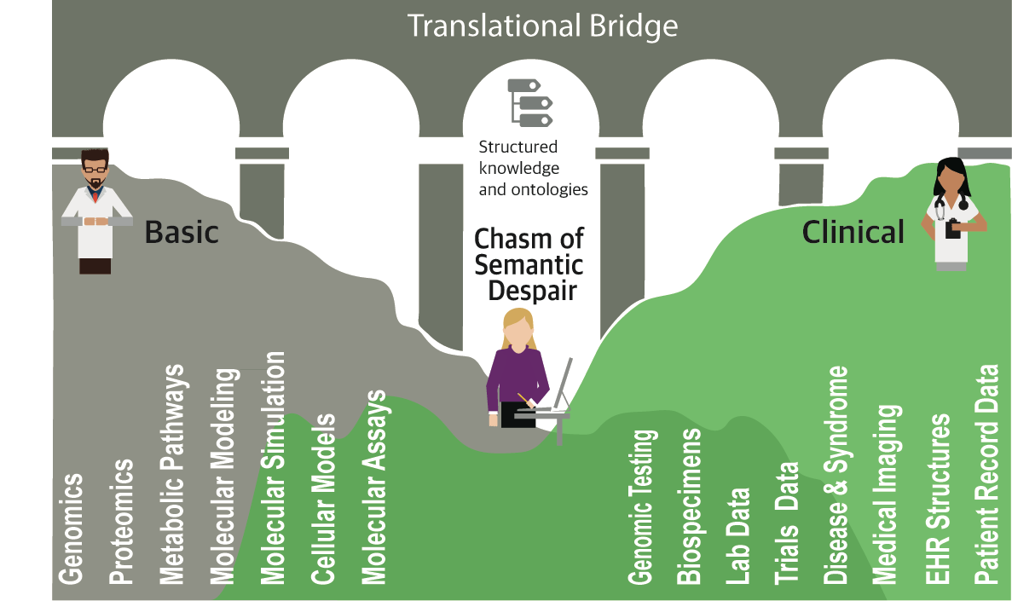
Chasm of Semantic Despair
Adapted from: Julie McMurry, Melissa Haendedl, Chris Mungall, Chris Chute (2017):
Chasm of semantic despair. figshare.
https://doi.org/10.6084/m9.figshare.4876838.v1
Notes:
In the context of biomedical research, there are many types of data being produced across the translational divide. Translational research is taking findings produced from basic science and translating it into medical practice to enhance human health and wellness. However, there are difficulties with integrating the data produced as an outcome of basic science and clinical practice because there is little overlap in the kinds of data that are produced, the reasons why they are produced and the ways the data are modeled.
I am a biologist living in the chasm of semantic despair. Our group is creating efforts to help align and structure these disparate types of data to make them more interoperable, discoverable and resuable by building ontologies to structure the data. What are ontologies?
--
Data across the biological and medical spectrum is difficult to use across modalities and translational stages. From bio to med there is little overlap in the kinds of data that are produced, the reasons they are produced, and the ways that they are modeled.
Why is it we are trying integrate data and ontologies are a part of this. Difference in data models, different vocabularies, difference in the kinds of users that are using data. There are people that know a lot about the science but not about the data modeling. We are trying codify the knowledge and make it useful to this overall effort.

Slide 3
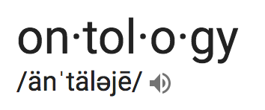


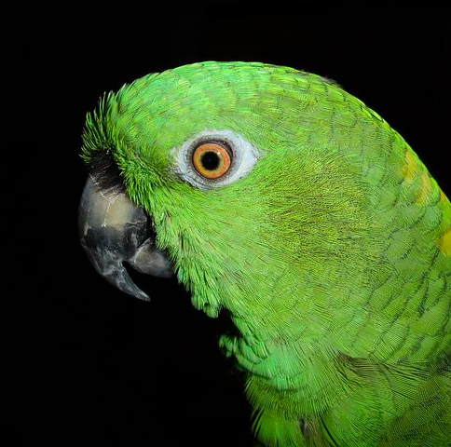
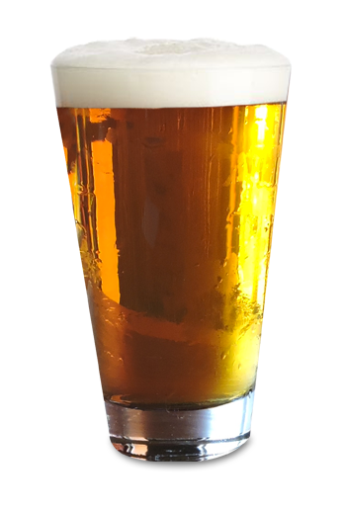
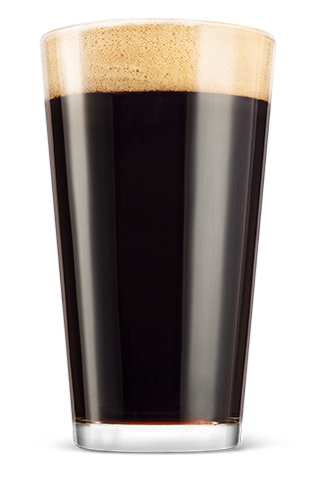



What is an ontology?
Beer
is_a
is_a
A knowledge classification comprised of terms that are formally defined and logically related.
Light beer
Dark beer
What are ontologies used for?
is_a
is_a
is_a
is_a
Literally anything
from e-commerce (amazon.com)
to ecology (the actual amazon rainforest)
Pilsner
Lager
Porter
Stout
Notes:
Define ontologies (because people may not know what they are)
Complicated logic needed for reasoners to work correctly- explain the nature of the problem that we are trying to solve
Build consistent ontologies without expert ontology builder
Need some sort of picture that shows that we are taking complex logic from the ontologies and flattening it into a table
Take patterns out of complex structures, and make it more simple

Slide 4
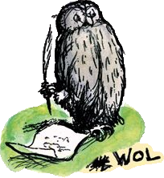
Ontologies are expressed in formal language like Web Ontology Language (OWL)
“Why not be inconsistent in at least one aspect of a language which is all about consistency?”
- Guus Schreiber, Why OWL and not WOL?
Notes:
Applications
Can be used to describe and structure datasets and experimental results
Used in a wide variety of applications:
recommender service on Amazon
rare disease diagnostics

Slide 5
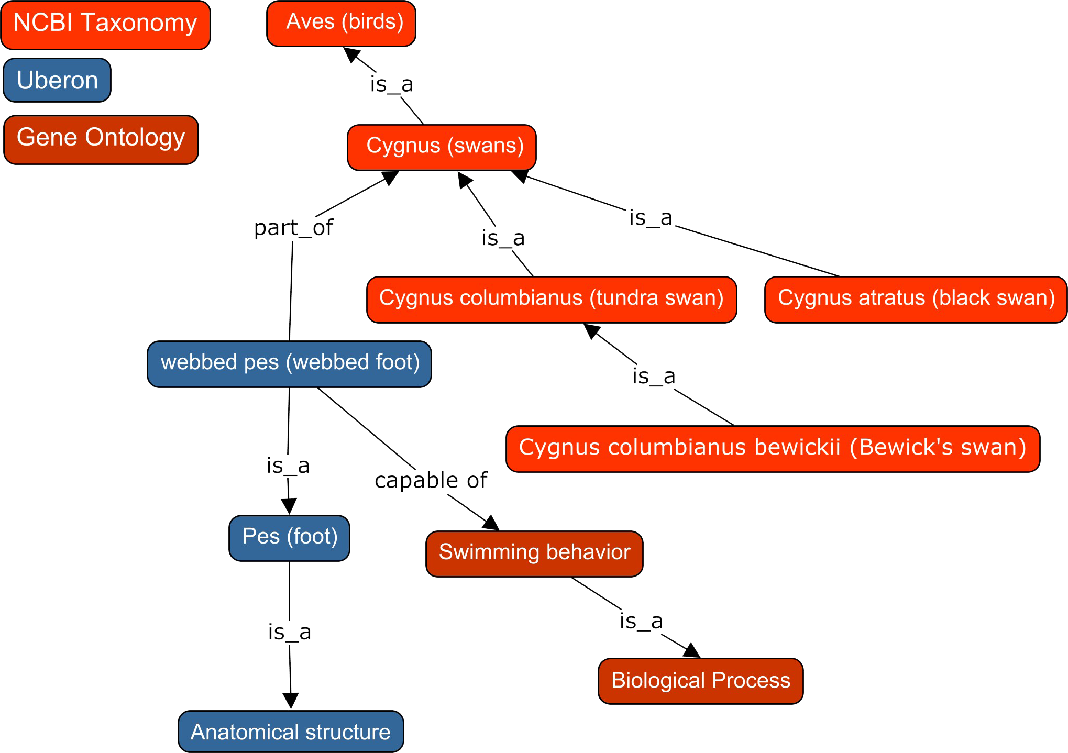
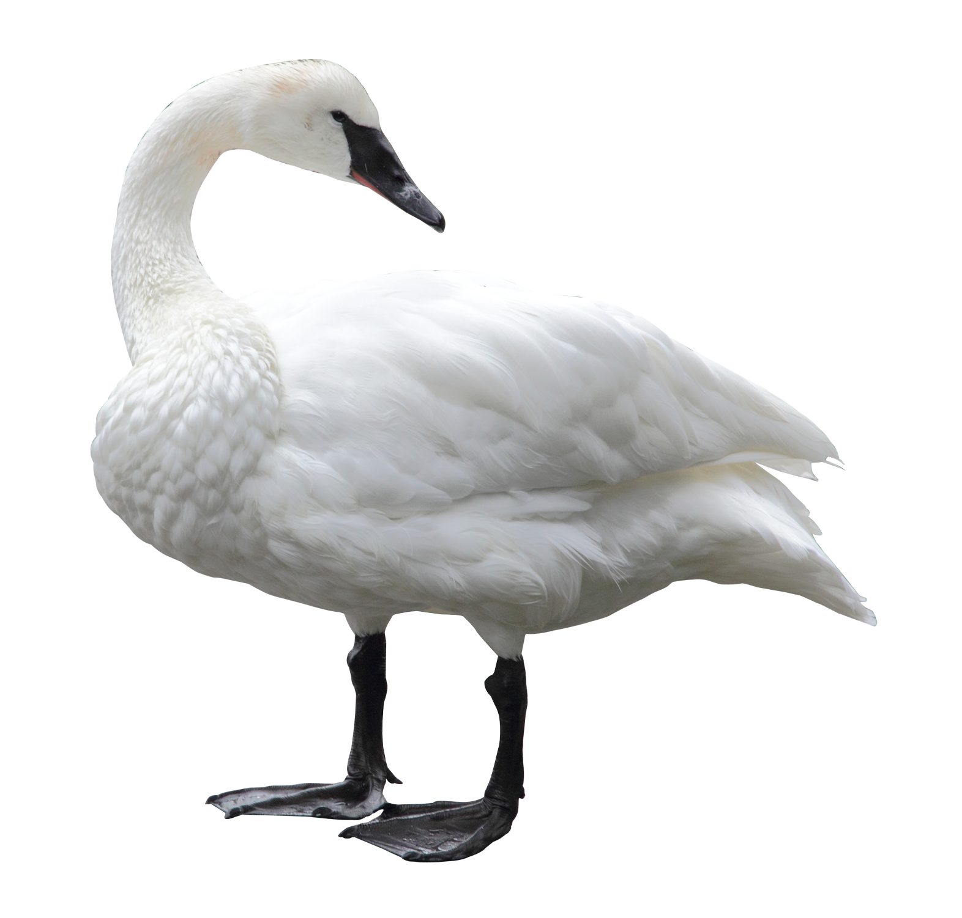
Swantology: Toph Allen
Ontologies are modeled using complex logic
@toph

Slide 6
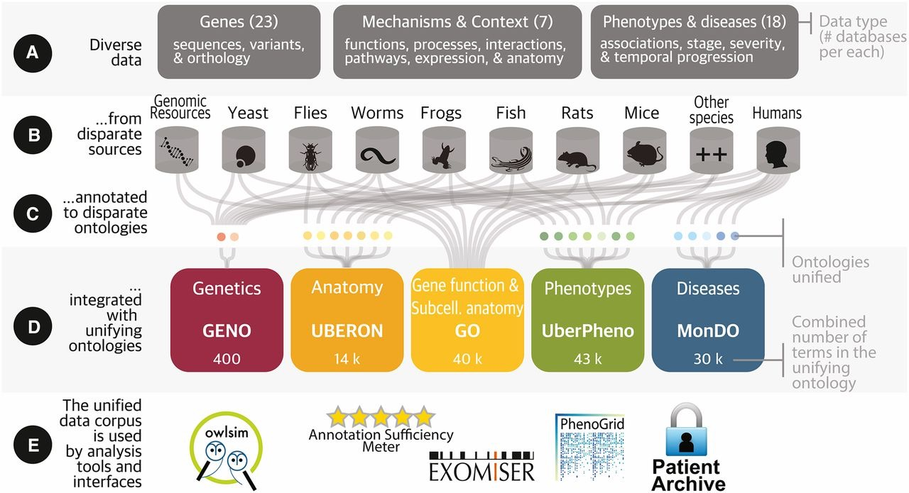

Ontologies are used to integrate diverse data post hoc
GENETICS August 1, 2016 vol. 203 no. 4 1491-1495;https://doi.org/10.1534/genetics.116.188870
Notes:
Have all these sources
Use different ontologies
Use ontologies to integrate them

Slide 7
Challenges in Ontology Development
U
R
V
E
C
G
N
I
Ontology development tools require specialized expertise
Difficult for domain experts to contribute to or develop community ontologies
N
R
A
L
E
Notes:
Good ontology development requires deep knowledge from domain experts, but the tools for building ontologies can be cumbersome and unintuitive. There sometimes is a disconnect between ontology tool developers and the domain experts and ontology uses. In many such contexts, domain experts revert to use of the plethora of csv-based tools.

Slide 8
Our approach: A New Kind of Table Editor
Desired features:
1
Enable domain experts to express their concepts
2
Familiarity and ease of use (ie table-based editing)
3
Ensure output of clean linked data in a standard format
https://github.com/INCATools/table-editor
Notes:
Good ontology development requires deep knowledge from domain experts, but the tools for building ontologies can be cumbersome and unintuitive. There sometimes is a disconnect between ontology tool developers and the domain experts and ontology uses. In many such contexts, domain experts revert to use of the plethora of csv-based tools.

Slide 9


Our approach: Table Editor
WEB APPLICATION
Deployed as a static website
Can view and edit spreadsheet formatted data
Autocomplete and selection from semantically associated ontologies and dictionaries
FORMAT
Supports formats:
TSV, Tab-Separated Values
CSV, Comma-Separated Values
Collectively referred to as XSV in software and documentation
https://github.com/INCATools/table-editor
Notes:
Imports/Exports table-oriented curated facts or models
Can be used with ordinary TSV/CSV
Lightweight, Storage-neutral
Icons from:
Il Capitano – Noun project
Costa Galaktionov, RU – Noun Project

Slide 10
How do we capture the complexity of the ontology logic in a spreadsheet?
THE SOLUTION
Dead Simple Ontology Design Patterns (DOSDP)
Editing OWL ontologies requires specifying OWL design patterns
Patterns are specified in the subset of YAML that can be converted to JSON
Can be used to:
Generate documentation
Generate new terms
Retrofit old terms
Allows for reuse of patterns
https://github.com/dosumis/dead_simple_owl_design_patterns
Notes:
By increasing rigor, can increase fidelity of analytics, machine learning, etc
Table-editor enables smart CSV and TSV editing
DOSDP provides a lightweight standard for specifying the design patterns

Slide 11
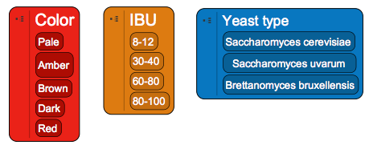

DOSDP for a Beer Ontology
Define types of beer:
Label: India Pale Ale
Synonym: IPA
Text definition: Is a hoppy beer style within the broader category of pale ale.
Source: https://en.wikipedia.org/wiki/India_pale_ale
Beer attributes:
How could we logically define an IPA by its attributes?
Notes:
I just made this up, but we probably don’t want to include something like this anyway…
OWL Logical definition: ‘has part’ some (pale and (‘has IBU’ some 60-80)) and (‘has fermentation type’ some ’top fermentation yeast’))

Slide 12
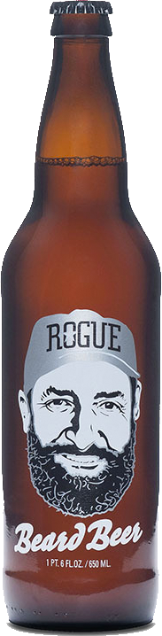
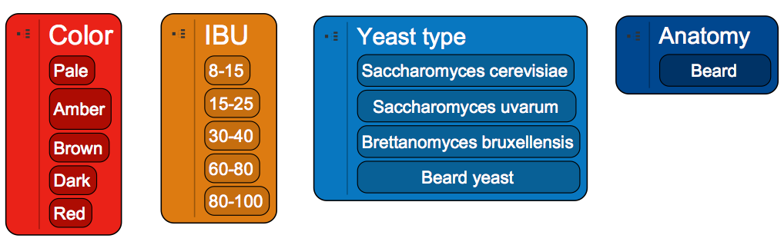
What other attributes are needed to define your favorite beer?
Rogue Beard Beer is brewed with a yeast discovered in Brewmaster John Maier's beard
http://buy.rogue.com/beard-beer/
Notes:
No Need to freak out, Brewers have used wild yeasts in beer making for centuries. John has had the same Old Growth Beard since 1983 and for over 15,000 brews, so it is no great surprise that a natural yeast ideal for brewing was discovered in his beard.”

Slide 13

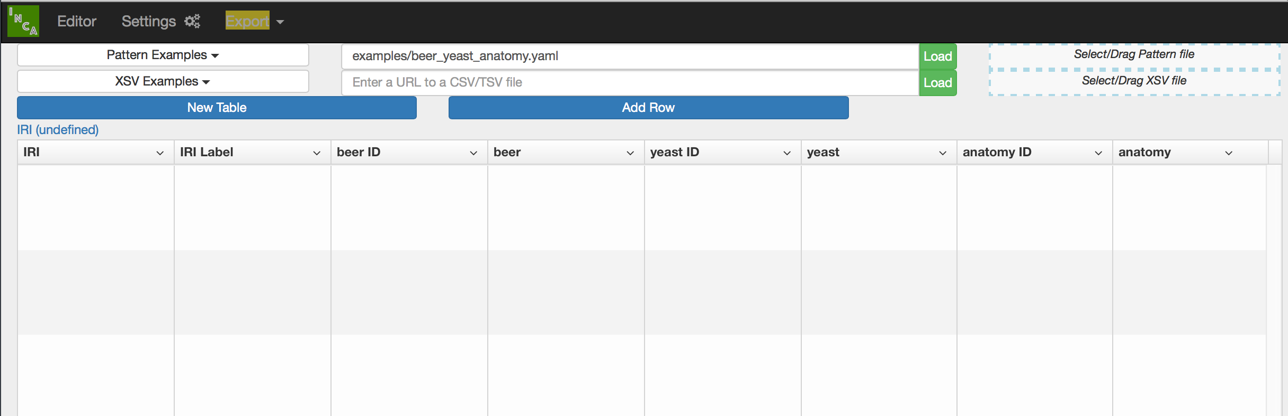

Ontology magic
Terms are constrained by the DOSDP
BEER:0000001
Beard beer
PATO:
0000324
Pale
NCBITaxon:
1051741
Beard yeast
UBERON:
0010167
Beard
BEER:0000002
IPA
PATO:
0000324
Pale
NCBITaxon:
4932
S. cerevisiae
BEER:0000003
Porter
PATO:
0000952
Dark
NCBITaxon:
4932
S. cerevisiae
Ontology IRIs are auto-filled
Users edit the CSV
How are the ontology classes generated from this spreadsheet?
Notes:
User edits CSV, with ontology IRIs filled in by autocomplete.

Slide 14
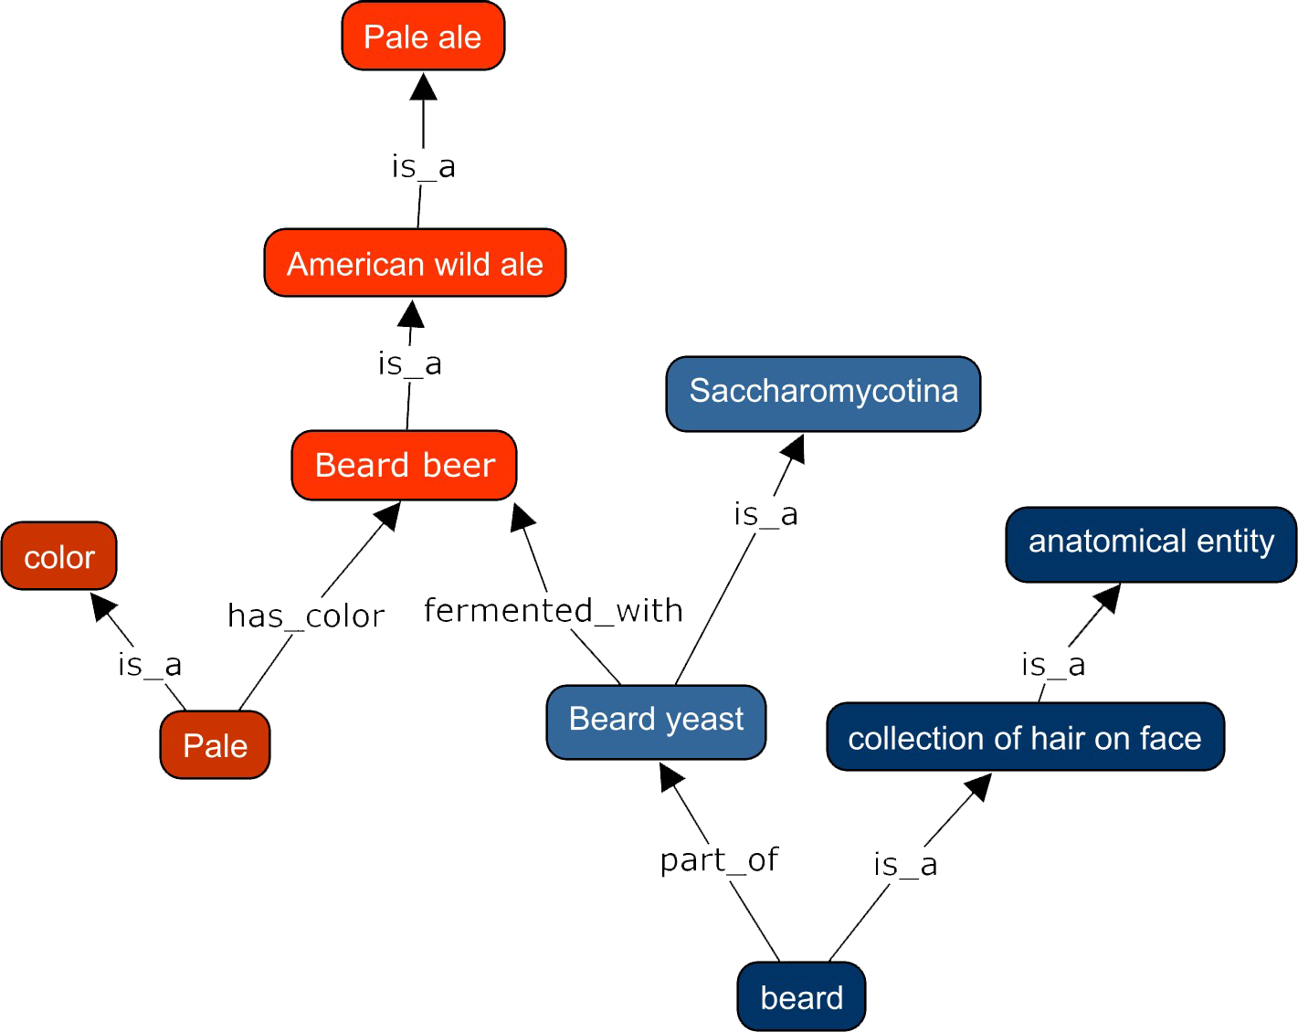
Structured code in the background
pattern_name: beerType
classes:
color: PATO:0000014
bitterness: IBU:0000001
yeast strain: NCBI:147537
anatomical entity: UBERON:0001062
relations:
inheres_in: RO:0000052
qualifier: RO:0002573
has_part: BFO:0000051
part_of: BFO:0000050
vars:
color: "color"
yeast strain: "'yeast strain'"
bitterness: "bitterness"
name:
text: "%s ale"
vars:
- color
annotations:
- annotationProperty: oio:hasExactSynonym
text: " %s"
vars:
- anatomical entity
def:
text: "A %s ale brewed from %s, obtained from a
%s, that has IBU %s."
vars:
- color
- yeast strain
- anatomical structure
- bitterness
equivalentTo:
text: "'has_part' some ('color' and ('inheres_in' some (%s and ('part_of' some '%s') and ('qualifier' some 'bitterness'))"
vars:
- yeast strain
- anatomical entity
Notes:
These building blocks are coming from the ontology, which is modeled as so

Slide 15

DOSDP Mapping in the background
pattern_name: beerType
classes:
color: PATO:0000014
bitterness: IBU:0000001
yeast strain: NCBI:147537
anatomical entity: UBERON:0001062
relations:
fermented_with: RO:0000052
qualifier: RO:0002573
has_part: BFO:0000051
part_of: BFO:0000050
vars:
color: "color"
yeast strain: "'yeast strain'"
bitterness: "bitterness"
name:
text: "%s ale"
vars:
- color
annotations:
- annotationProperty: oio:hasExactSynonym
text: " %s ale"
vars:
- anatomical entity
def:
text: "A %s ale that is brewed from %s, obtained from a
%s, that has an IBU %s."
vars:
- color
- yeast strain
- anatomical structure
- bitterness
equivalentTo:
text: "'has_part' some ('color' and (’fermented_with' some (%s and ('part_of' some '%s') and ('qualifier' some %s))"
vars:
- yeast strain
- anatomical entity
- bitterness
Beard ale
A pale ale that is brewed from beard yeast, obtained from a beard, that has an IBU 15-20.
Pale ale

Slide 16
Technical architecture
OldData.csv
GitHub: INCATools/table-editor
NewData.csv
AngularJS, Bootstrap
ui-grid
PapaParse, js-yaml
GitHub Pages
Pattern.yaml
Shared Ontologies
NCBI
PATO
HPO
BEER
NewData.OWL
Python, requires Server
CSV Rows expanded to OWL statements
DOSDP-to-OWL
GitHub: dosumis/dead_simple_owl_design_patterns
Notes:
Tweet ahead of time
Let’s create an ontology of something funny (nw beer)
Ask for a volunteer

Slide 17
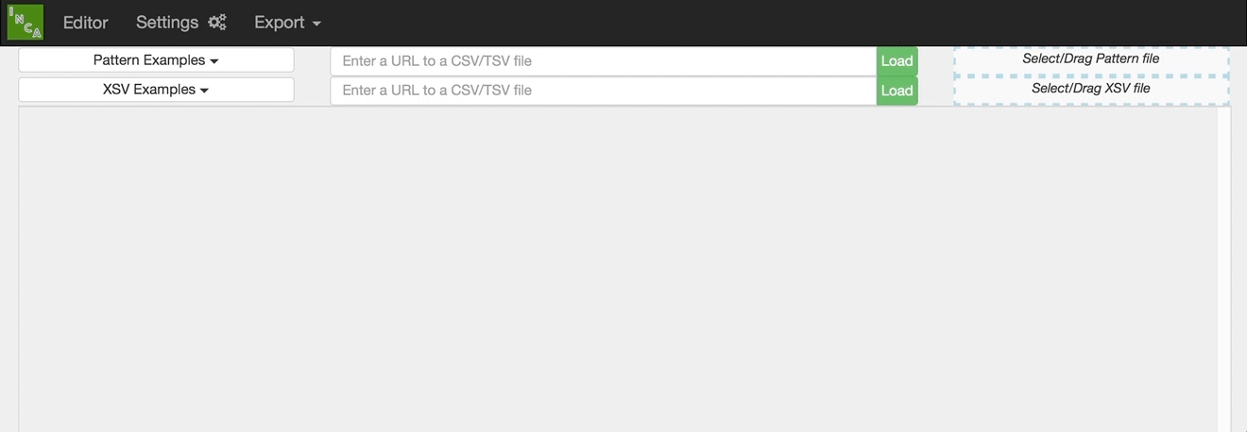
Demo - Choose a Pattern
DOSDP Patterns can be selected via:
Choose from predefined list
Drag and Drop from Desktop
Refer to URL of external pattern resource
https://github.com/INCATools/table-editor

Slide 18
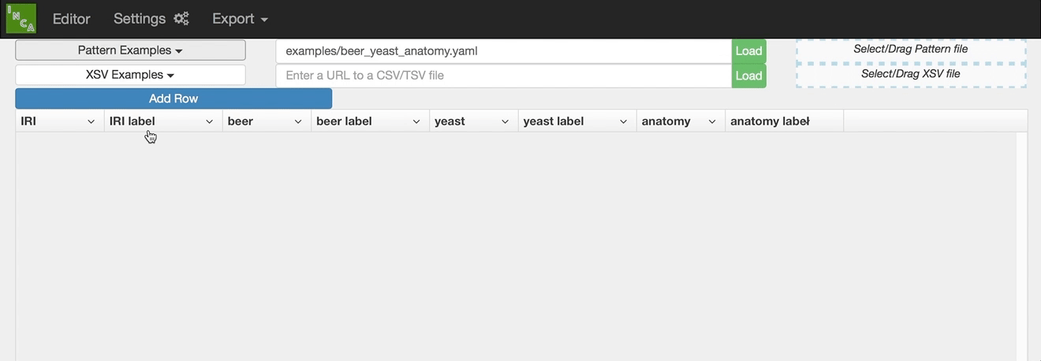
Demo - Define Beers
New Beers can be defined:
Add a Row
Fill in Attributes
Default Name is autopopulated
https://github.com/INCATools/table-editor
Notes:
Tweet ahead of time
Let’s create an ontology of something funny (nw beer)
Ask for a volunteer

Slide 19
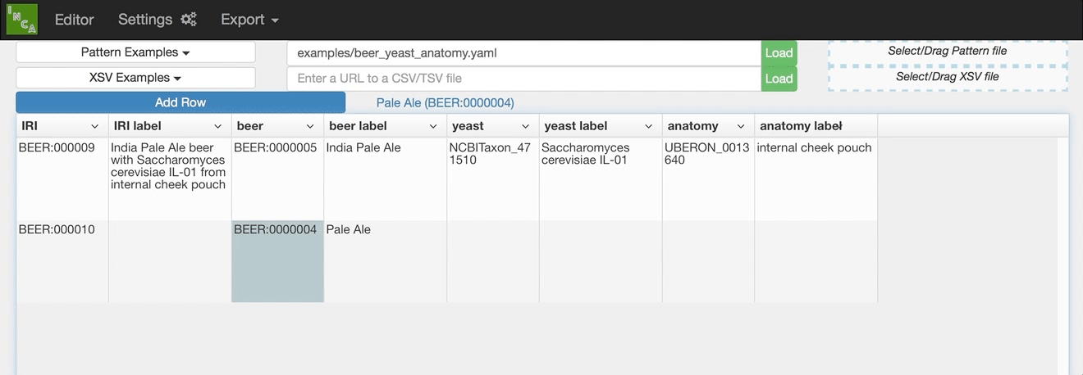
Demo - Export Beers to CSV
Export the resulting Beer definitions
Save to desktop
Save directly back to GitHub (NYI)
https://github.com/INCATools/table-editor
Notes:
Tweet ahead of time
Let’s create an ontology of something funny (nw beer)
Ask for a volunteer

Slide 20




Use the table editor to:
Contribute to and extend existing ontologies
Create new ontologies
Data curation
https://github.com/INCATools/table-editor
Notes:
Current process of ontology editing is slow – depends on people making requests on issue tracker and trained ontology editors make the updates
What can people who are there for the conference take away?

Slide 21






Acknowledgments
Melissa Haendel
OHSU
Chris Mungall
LNBL
Peter Robinson
Jax
Julie McMurry
OHSU
David
Osumi-Sutherland
University of Edinburgh
Jim Balhoff
University of North Carolina
FUNDING: 1U01 HG009453-01

Slide 22

THANK YOU
You can find us at:
@n_vasilevsky
vasilevs@ohsu.edu
@TheDoctorBud
keitda@ohsu.edu
Interested in developing tools like this?
We may be hiring in the future.
Contact info@monarchinitiative.org with your CV or link to bio.

